Slide 1
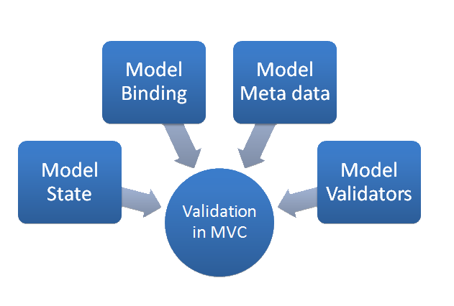


ASP.NET MVC Working with Data
Nikolay Kostov
Team Lead, Senior Developer and Trainer
http://Nikolay.IT
Telerik Software Academy
academy.telerik.com

Slide 2

Table of Contents
Session[], TempData[], Cache[]
Model Binders
Data Validation
Data annotations
Unobtrusive Validation
Server-side vs. Client-side
Editor Templates, Display Templates

Slide 3
Table of Contents (2)
Working with real data
Repository Pattern
Unit of Work Pattern
Scaffolding

Slide 4

Model Binders

Slide 5
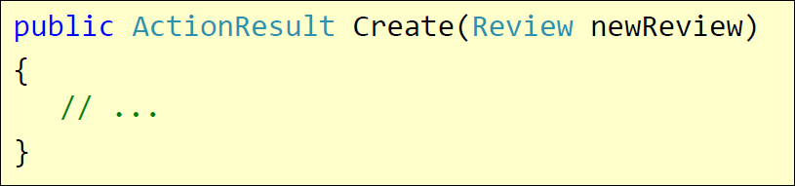
Model Binders
To make east of handling HTTP post request
Help the populating the parameters in action methods
DefaultModelBinder
HTTP POST /Review/Create
Rating=7&Body=Great!

Slide 6
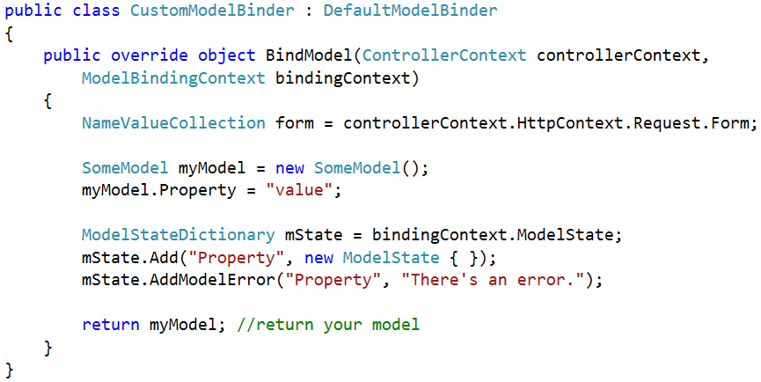
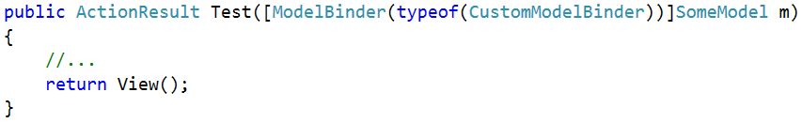
Custom Model Binder

Slide 7

Data Validation

Slide 8
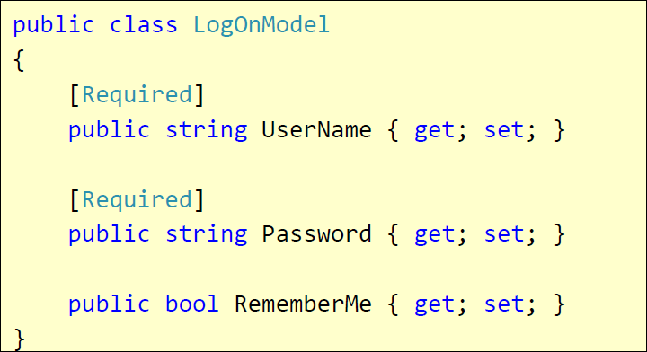
Validation with Annotations
Attributes defined in System.ComponentModel.DataAnnotations
Covers common validation patterns
Required
StringLength
Regex
Range

Slide 9
Data Validation Attributes
Attribute | Description
Compare | Checks whether two specified properties in the model have the same value.
CustomValidation | Checks the value against the specified custom function.
EnumDataType | Checks whether the value can be matched to any of the values in the specified enumerated type.
Range | Checks whether the value falls in the specified range. It defaults to numbers, but it can be configured to consider a range of dates, too.
RegularExpression | Checks whether the value matches the specified expression.
Remote | Makes an Ajax call to the server, and checks whether the value is acceptable.
Required | Checks whether a non-null value is assigned to the property. It can be configured to fail if an empty string is assigned.
StringLength | Checks whether the string is longer than the specified value.

Slide 10
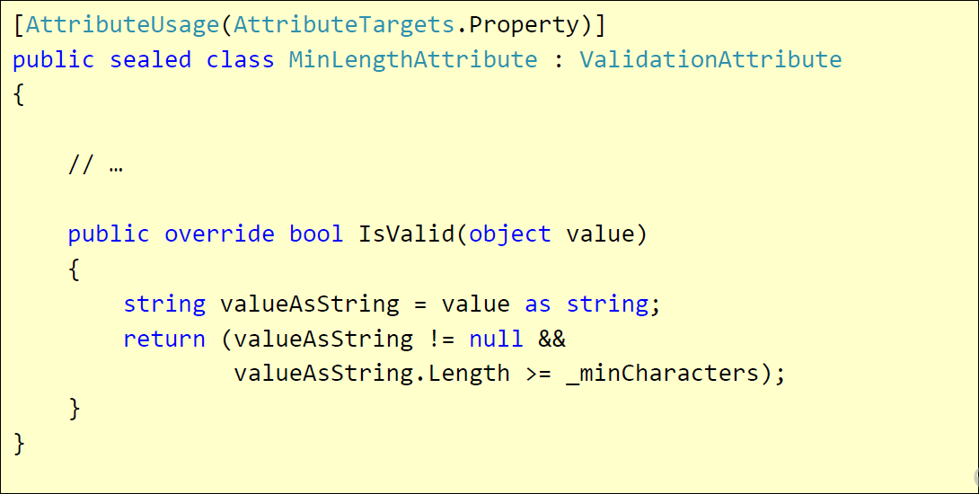
Custom Validation
Custom attributes
Inherit ValidationAttribute

Slide 11
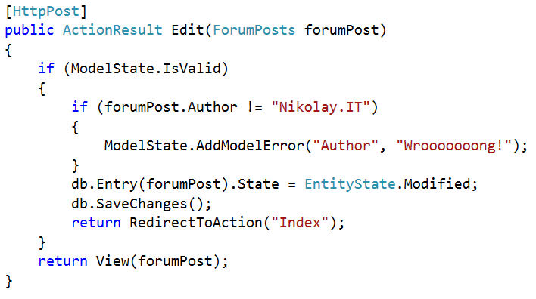
Validating Model – Controller
ModelState.IsValid – will give us information about the data validation success
ModelState.AddModelError – custom error

Slide 12
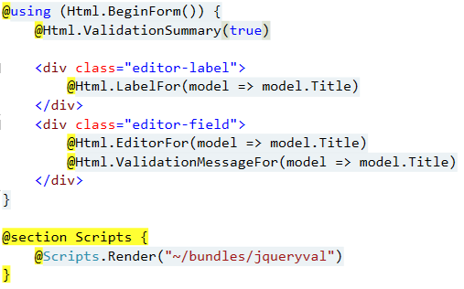
Validating Model – View
@Html.ValidationSummary – output errors
@Html.ValidationMessageFor(…) – outputs validation message for specified property
Text box with integrated client-side validation
jQuery validation library required for unobtrusive JavaScript validation

Slide 13
Display / Edit Annotations
Attribute | Description
DisplayColumn | Specify the property of a model class for simple text display.
HiddenInput | Render value in a hidden input (when editing).
UIHint | Specify the name of the template to use for rendering.
DataType | Common templates (email, password, URL, currency)
ReadOnly | Specify a read-only property (for model binding).
DisplayFormat | Format strings and null display text
ScaffoldColumn | Turn off display and edit capabilities
DisplayName | Friendly name for labels

Slide 14
Working with Real Data

Slide 15
TODO

Slide 16
Scaffolding

Slide 17
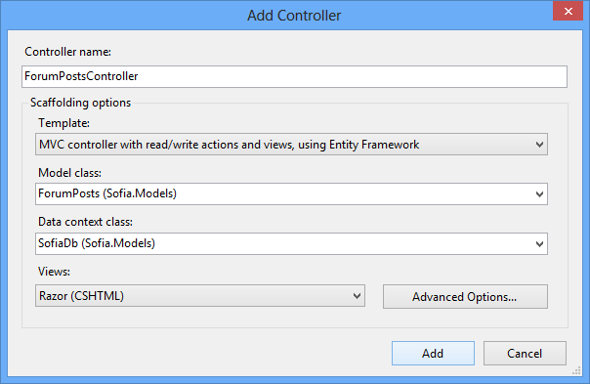
Controller and View Templates
TODO: Editor templates and view templates

Slide 18
Summary
TODO: Summary

Slide 19
ASP.NET MVC Working with Data
http://schoolacademy.telerik.com

Slide 20
Homework
TODO

Slide 21



Free Trainings @ Telerik Academy
“C# Programming @ Telerik Academy
csharpfundamentals.telerik.com
Telerik Software Academy
academy.telerik.com
Telerik Academy @ Facebook
facebook.com/TelerikAcademy
Telerik Software Academy Forums
forums.academy.telerik.com

